Slide 1

Acropolis Institute of Technology & Research, Indore
www.acropolis.in

Slide 2

Title of the Project
Submitted to: Department of Information Technology/CSE-DS/CSE-IoT

Slide 3
Team Members 1.
2.
Supervised by: Prof.
3.
4.
‹#›

Slide 4
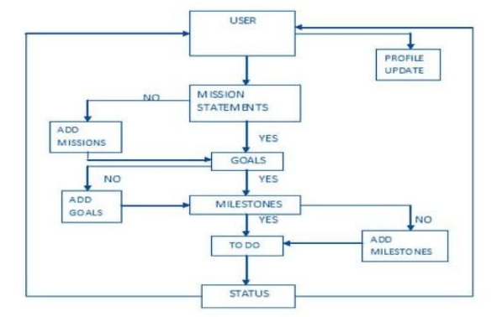
User Module
‹#›

Slide 5
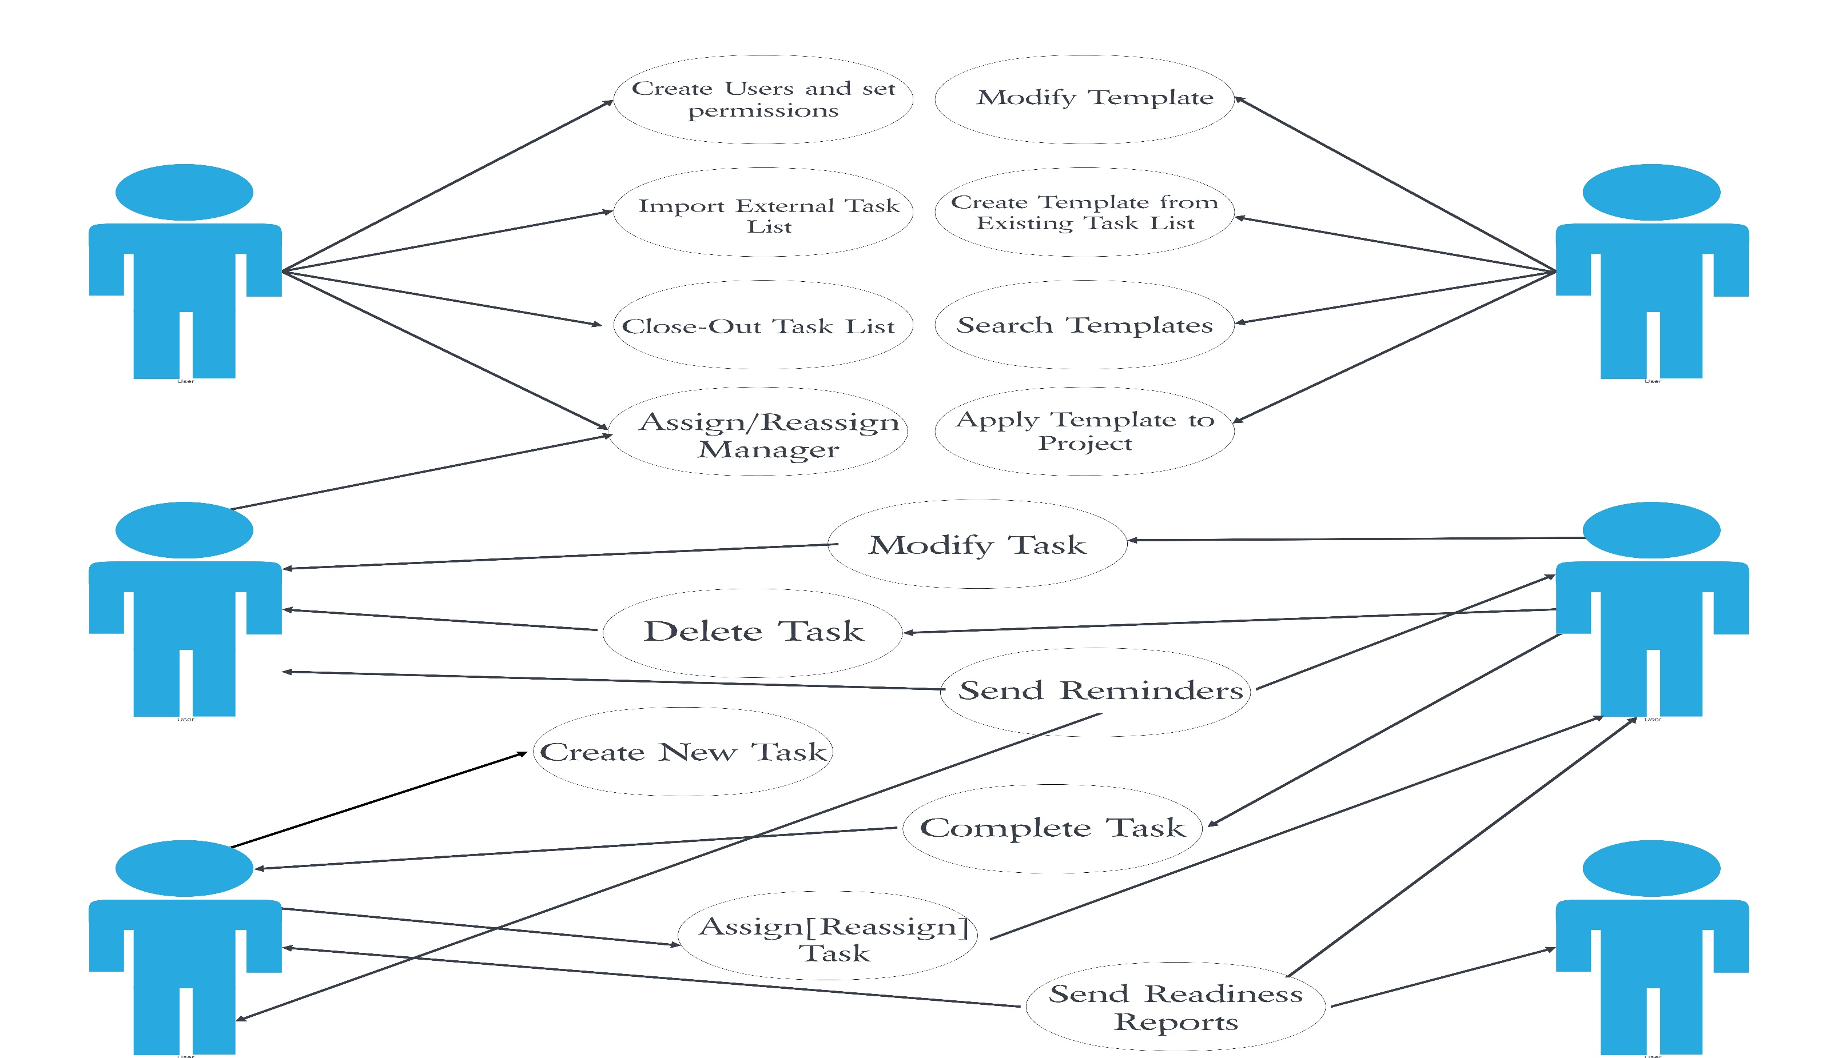
Use Case Diagram

Slide 6
E-R Diagram

Slide 7
Acknowledgment
‹#›

Slide 8
Q&A
‹#›

Slide 9
THANKS
‹#›

